Slide 1
Predicting Flight Delays
Data-Driven Insights for Operational Efficiency
Created By: Anusha Bhat, Kirthi Rao, Manas Vemuri, and Sumasree Ragi

Slide 2






Agenda
Business Problem
Defining the challenge and project goals
EDA
Uncovering data quality and patterns in the data
Model Evaluation
Assessing model performance and accuracy
Data Cleaning & Preparation
Ensuring data quality for reliable analysis
Model Development
Building a Binomial Logistic Regression model to predict delays

Slide 3

Business Problem
Flight delays disrupt operations and customer satisfaction, requiring airlines to manage schedules proactively.
Using binomial regression, we aim to predict the probability of a flight delay based on factors like departure time, distance, and origin-destination pairs.
This model will enable data-driven decisions to reduce delays and improve airline reliability.

Slide 4
Data Summary
Dataset containing time and travel information of all domestic US flights in January 2019
Total of 583,985 flights
346 airports
Collected by Bureau of Transportation Statistics, sourced from Kaggle
Flights during all times of day, from high, medium, and low volume airports, and both budget and non-budget airlines
21 original features, 8 retained
Departure delay is our target column
17.42% of flights were delayed
Notes:
For our project we used a dataset created by the Bureau of Transportation Statistics containing time and travel information of all domestic US flights in January 2019. There are a little under 584,000 flights from 346 unique origin and destination airports in our dataset. The flights operate between high, medium, and low volume airports as well as both budget and non-budget carriers. We originally had 21 features, but only retained 8, which we’ll discuss further in the next slide. For our model, we ultimately decided to predict departure delays so the delay column will function as our target column, with 17.42% of flights in our dataset being delayed.

Slide 5
Data Cleaning
Originally had 21 columns on day of month, day of week, different carrier codes, arrival and departure airports, tail number, flight number, departure and arrival time, diverted, cancelled, and distance
Only retained 8 columns
Independent variables: Day of month, day of week, carrier type, departure and arrival airport type, departure time block, and distance
Dependent Variable: Delay.
Reclassified carrier type from IATA codes to the categories budget v.s. non-budget
Reclassified departure time block from hourly intervals to time of day categories
Pre-dawn, early morning, morning, noon, afternoon, evening, night
Created a new columns for arrival and departure airport type
Originally had airport codes
New columns have 3 categories: high, medium, and low volume flight traffic

Slide 6
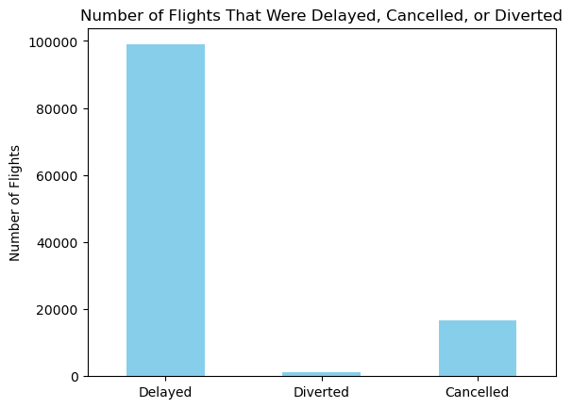
More flights were delayed compared to the number of flights that were cancelled or diverted
Due to the discrepancy in count, we only used departure delay as the dependent variable.

Slide 7
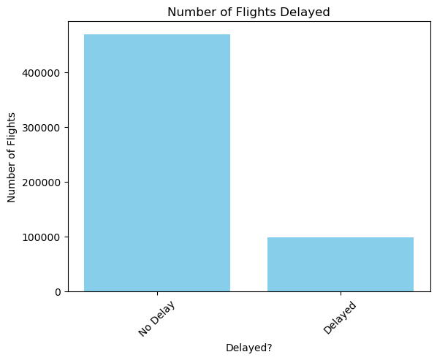
Most Flights Experienced No Delay
Indicates potential need to undersample for a balanced model.

Slide 8
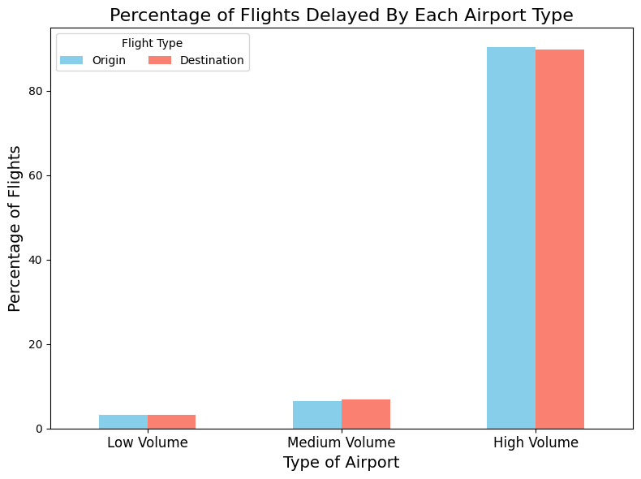
Most of the Delayed Flights Were From High-Volume Airports
 | Origin | Destination
Low volume | 3.20% | 3.30%
Medium volume | 6.43% | 6.959%
High volume | 90.37% | 89.752%

Slide 9
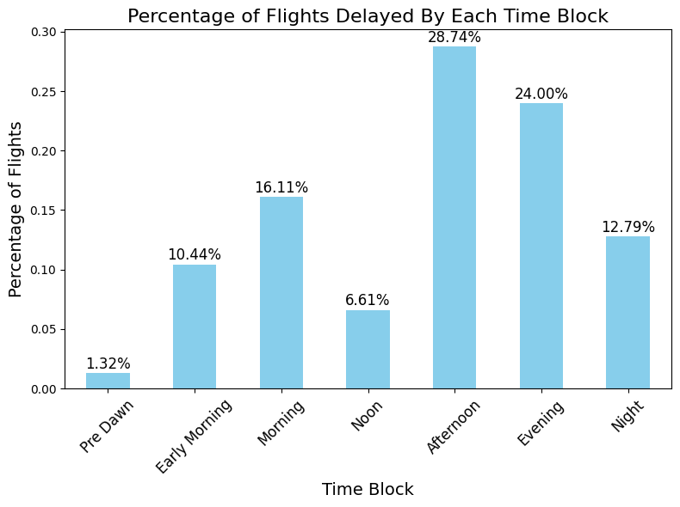
Most Delayed Flights are Later in the Day, after 12:00 pm

Slide 10
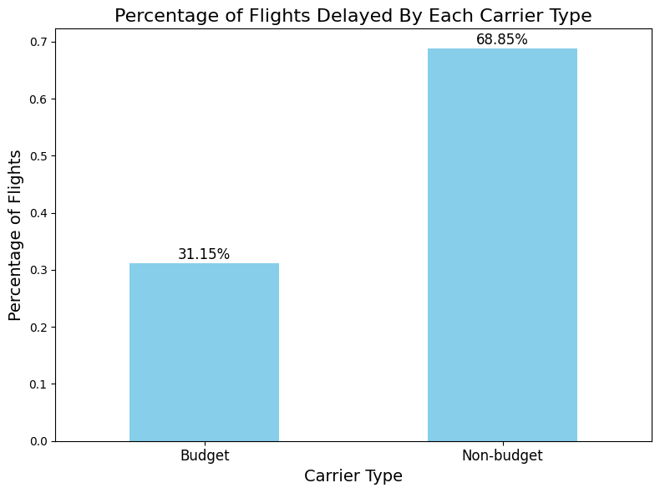
Most Delayed Flights Were From Non-Budget Airlines (Delta, United Airlines, American Airlines, and Subsidiaries)

Slide 11
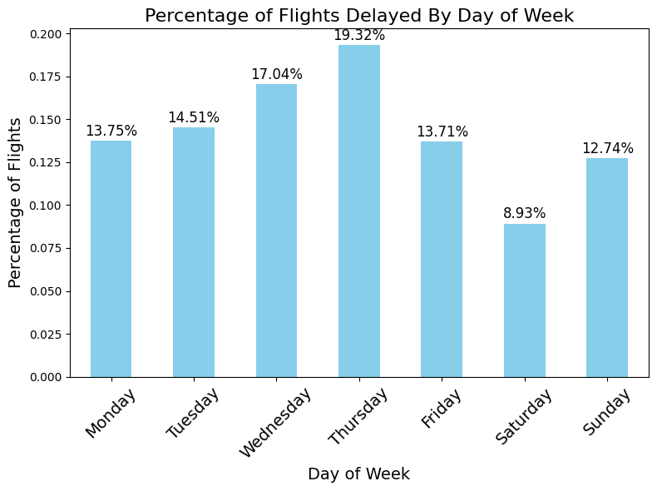
Thursday Has the Highest Percentage of Delayed Flights, while Saturday has the Lowest Percentage

Slide 12
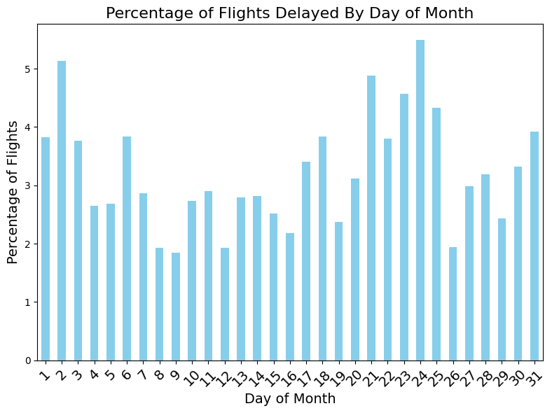
The Beginning of the Month and Days 20-25 Have Higher Proportions of Delayed Flights

Slide 13
Model Choice
Model | Notes
Linear Regression | Works for continuous outcome variables and for our case we are working with a categorical outcome Would Work if: predicting how long a flight was delayed for
Count Regression | Since we are not attempting to count the occurrences of something, this model was not a good fit Would Work if: predicting number of delays
Multinomial Regression | Since we are only predicting two categories this model was not used Would Work if: predicting more outcomes like cancelled and diverted flights
Binomial Logistic Regression | Optimal choice since we are predicting two outcomes: delay or no delay Using the logit link function we can output the percentage chance of a delay, which can allow for adjusting the model depending on user’s risk tolerance

Slide 14

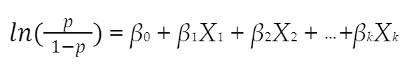
Logistic Regression - Logit Function
Logistic Regression is a form of Binomial Regression that uses the logit link function.
The logit function maps the probability of an event to the log-odds
Allows for a linear model to be applied to a binary outcome

Slide 15
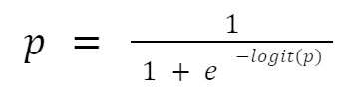
Logistic Regression - Logistic Function
Logistic function: inverse of logit function
Used to convert the log-odds back into probability values
This value tells you the probability of the response variable occurring
Threshold prediction of 1 if p ≥ 0.5

Slide 16
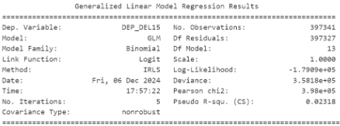


Model Estimation Method
Maximum Likelihood Estimation (MLE) via Iteratively Reweighted Least Squares (IRLS)
Iterative method that combines the Newton-Raphson method with weighted least squares to find the maximum likelihood estimates of the model parameters
MLE is a statistical method aimed at finding the best-fit parameters for a model
IRLS is a specific algorithm used to achieve this goal in the context of GLMs
where:

Slide 17
Model Creation
Undersampling Delays
Run Model with All Combinations
Evaluate Metrics
The dataset contained only 17% delayed flights. To allow the model to predict more delays we undersampled the on-time flights by randomly sampling 60% of them
Created an intercept only model. Then using itertools we train the GLM with a logit link function for each combination of the available features
For each model we examine the BIC. Using this goodness of fit measure we are able to see what set of features perform the best

Slide 18
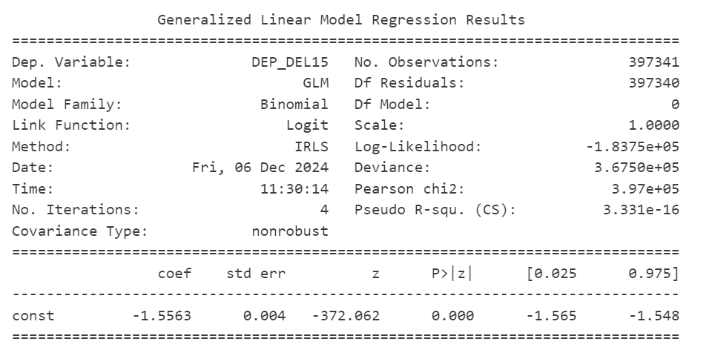
Intercept-Only Model
Interpretation:
Intercept represents the log-odds of a flight being delayed when all predictor variables are zero
Negative intercept suggests a low probability of delay

Slide 19
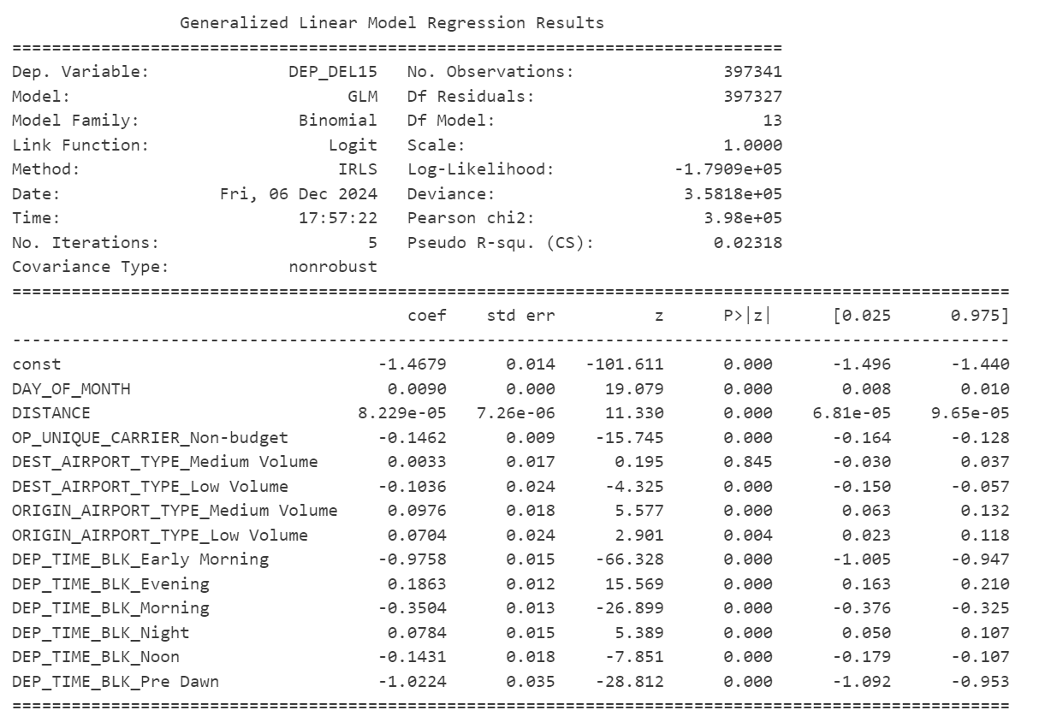
Final Model Construction Using BIC
Interpretation:
As both day of month and distance increase, delay odds slightly increase
Early morning, morning, noon, and pre-dawn departures have lower delay odds compared to afternoon departures
Evening and night departures have higher delay odds compared to afternoon departures

Slide 20

Sample Predictions
Flight 1:
Origin: Long Beach (LGB)
Destination: Boston (BOS)
Airline: JetBlue
Date: Thursday, 01/31/2020
Time: 8:33 PM
Distance: 2,602 miles
Predicted Delay Odds: 31.2%
Flight 2:
Origin: Lubbock, TX (LBB)
Destination: Dallas, TX (DAL)
Airline: Southwest
Date: Wednesday, 01/02/2020
Time: 5:27 AM
Distance: 293 miles
Predicted Delay Odds: 6.3%

Slide 21
Model Evaluation Metrics
F1 Score: 32%
Poor balance between precision and recall
32% in training data as well
Accuracy: 61%
Our model correctly predicts delays 61% of the time
Using a threshold of 20% for predicting delays
Accuracy in training data is also 61%
Confusion Matrix
True Positives
87,846
False Positives
52,724
False Negatives
13,854
True Negatives
15,865

Slide 22
Future Improvements
01
Many common factors for flight delays are not included in this dataset. For example weather and the previous flight are important factors in predicting flight delay.
With adding this data, we would likely be able to better predict delays.
Collecting More Possible Predictors
02
In the current dataset these types of flights made up less than 1% of the data.
As a result we could not create a meaningful multinomial model.
Getting more data on cancelled and diverted flights
03
For storage and code runtimes we used just one month of data.
With data over the course of multiple years we could better account for seasonality.
Optimizing data flow and processing to collect data over wider time range
Notes:
Presenting by Suma

Slide 23




Key Takeaways
The final model effectively identifies key factors influencing flight delays, improving classification accuracy to 61%.
Distance, day of month, departure times, airline types, and airport volume emerged as the most impactful predictors of delays.
Significant
Features
Predictive
Insights
Early morning and pre-dawn flights are the most reliable, while evening departures face higher risks of delays.
Non-budget carriers and low-volume destination airports offer better on-time performance.
Operational
Insights
Business Implications
Notes:
Presenting by Suma

Slide 24
Thank you!

Slide 25
Appendix

Slide 26
Link to Dataset
https://www.kaggle.com/datasets/divyansh22/flight-delay-prediction

Slide 27
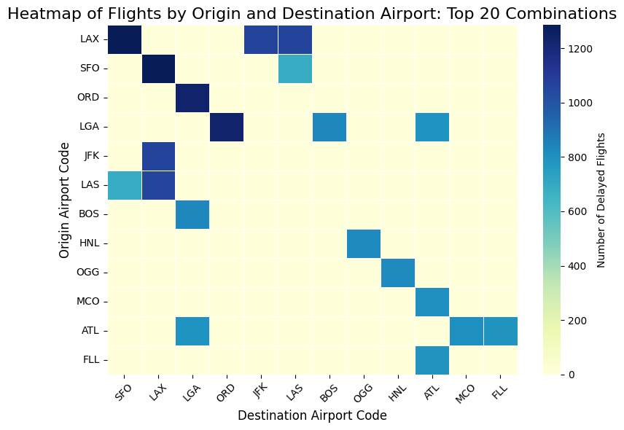
Combinations between LAX-SFO, ORD-LGA, JFK-LAX, and LAS-LAX have the highest number of flights to and from each airport.

Slide 28
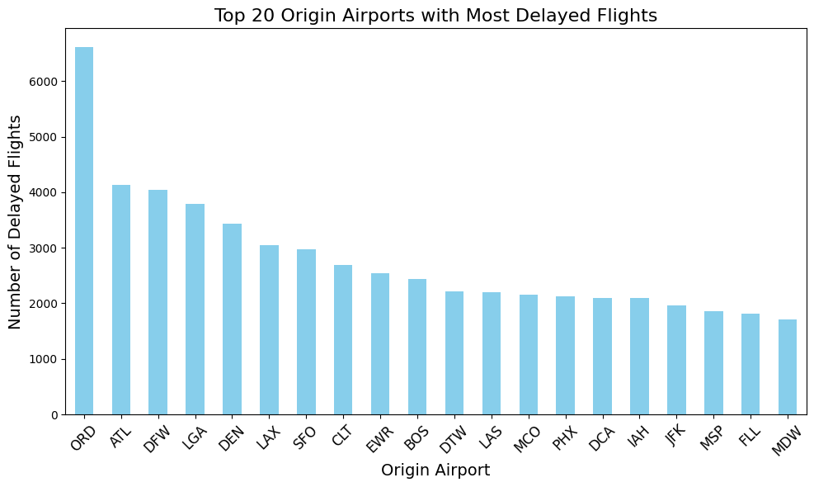
ORD, ATL, DFW, LGA, and DEN Have the Most Delayed Flights For Origin Airports

Slide 29
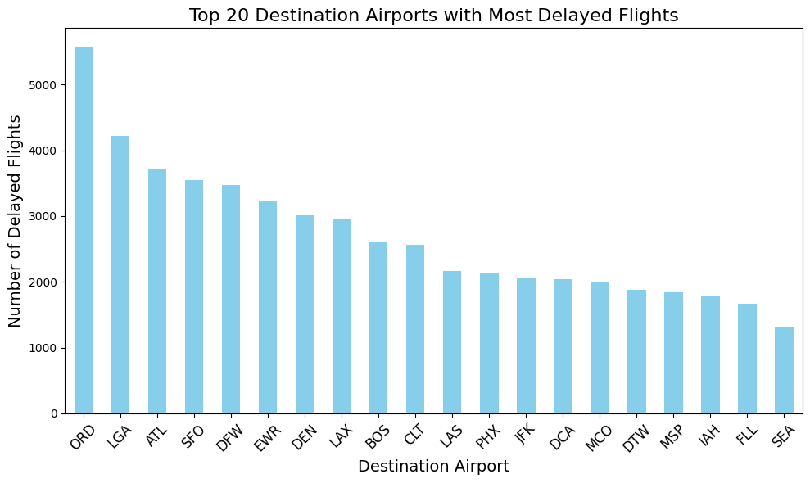
ORD, LGA, ATL, SFO, and DFW Have the Most Delayed Flights For Destination Airports

Slide 30
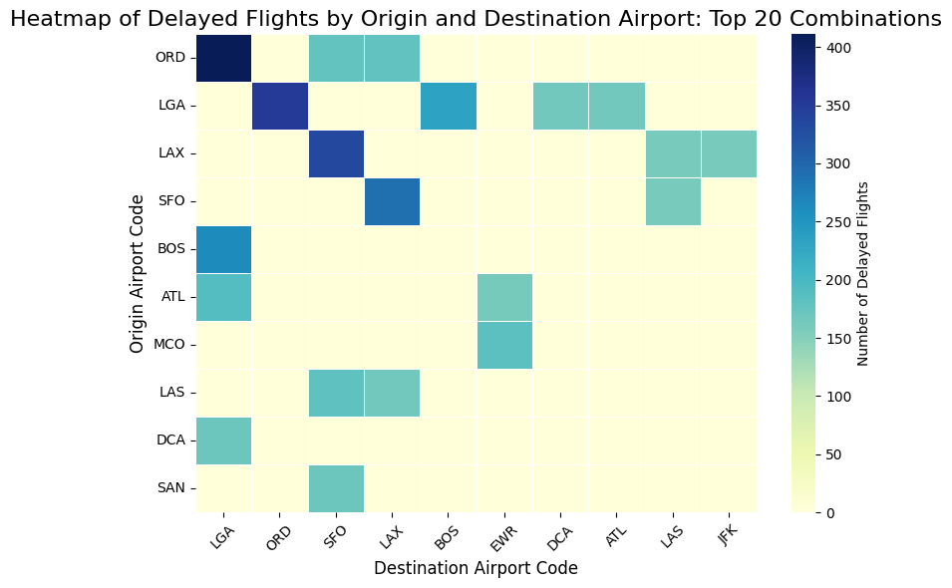
Combinations between LAX-SFO, ORD-LGA, and BOS-LGA, have the highest number of delayed flights to and from each airport

